Slide 1

Defining Digital Twin for Industry 4.0 _____________________________________________________________________________________________ Masters Thesis Defense
Presented by: Zachary deWardener
Department: Mechanical, Industrial and Systems Engineering
December 1, 2023

Slide 2
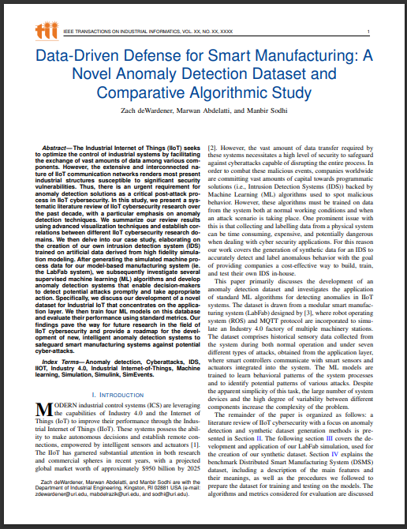
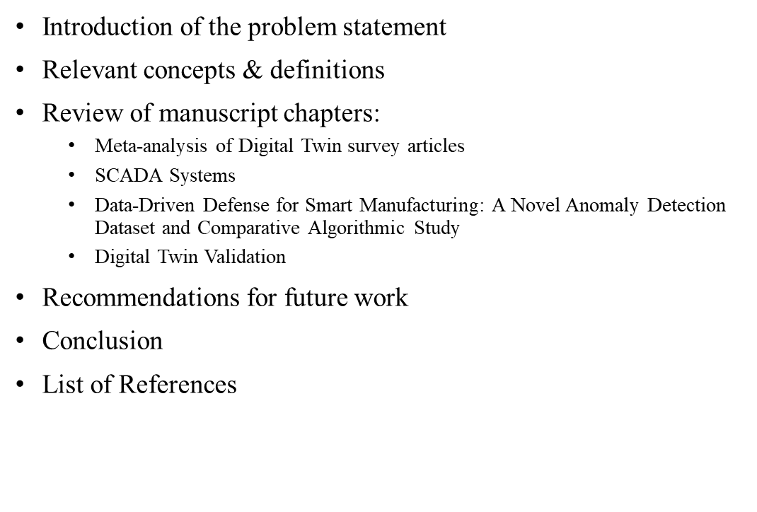
Overview
Redefining the Digital Twin
Overview
Problem Statement
Concepts & Definitions
Manuscript Review
Recommendations
Conclusion

Slide 3
Introduction of the Problem Statement
Problem Statement
Despite the rising interest and potential of Digital Twin (DT) technology, the field is currently hampered by a lack of precise, use-case-centric definitions and a standardized approach to classification and validation. The prevailing broad definitions of DTs in literature are often conflated with the capabilities of Supervisory Control And Data Acquisition (SCADA) systems, leading to a misunderstanding of DTs' unique attributes and capabilities. This confusion poses a significant challenge in distinguishing DTs from other simulation models, particularly when defining the requirements for an automatic, bi-directional data transfer. Furthermore, the current trajectory of DT research is largely self-referential, creating information silos that may not adequately address the diverse and specific needs of various industrial applications.
[Agenda 1]
Overview
Material
Research Questions
Reducing PU
Manuscript 1
[Agenda 4]
Reducing Nylon
[Agenda 5]
Recommendations
Problem Statement
Concepts & Definitions
Manuscript Review
Recommendations
Conclusion
Overview
[Agenda 2]
[Agenda 3]
Simulation
Recommendations
3
[Agenda 1]
Reducing PU
Reducing Nylon
[Agenda 4]
[Agenda 5]
Overview
Research Questions
Manuscript 1
[Agenda 2]
[Agenda 3]
Material

Slide 4








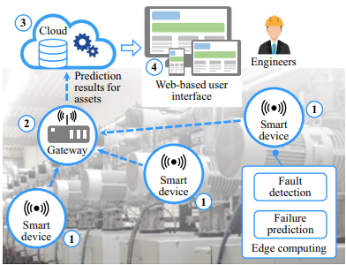
Relevant Concepts and Definitions: Industry 4.0 & IIOT
Industry 1.0
(late 18th century-early 19th century)
Industry 2.0
(late 19th century-early 20th century)
Industry 3.0
(late 20th century)
Industry 4.0
(Present day)
Utilization of water and steam power.
Mechanization of the iron and textile industries.
Introduction of electrification and mass production through assembly lines.
Digitalization through computers and IT.
Automation of manufacturing processes through robotic integration.
Introduction of smart factories through mass data exchange brought by IOT technology.
Artificial Intelligence integration.
Additive manufacturing, VR/AR, etc.
An IIOT platform for predictive maintenance of industrial assets, Thelen [1].
Industrial Revolutions leading to present day.
[Agenda 1]
Reducing Nylon
Simulation
Recommendations
Overview
[Agenda 1]
Material
Research Questions
Research Questions
Reducing PU
Manuscript 1
Manuscript 1
[Agenda 4]
Reducing Nylon
[Agenda 4]
[Agenda 5]
Recommendations
Overview
[Agenda 5]
Problem Statement
Concepts & Definitions
Manuscript Review
Recommendations
Conclusion
[Agenda 2]
[Agenda 2]
[Agenda 3]
Material
[Agenda 3]
Overview
Reducing PU
4

Slide 5
Review of Manuscript Chapters: General Flow of Information
Redefining the Digital Twin
Brief historical and contextual overview.
Our proposed definition of DT.
SCADA Systems
Evolution and current standing of SCADA technology.
Applications and challenges faced.
Data-Driven Defense for Smart Manufacturing
Overall goals within the study.
Digital Twin Validation
Current validation methods used for DT systems.
Our proposed method for standardized model validation.
DT model creation and use.
Future of SCADA systems
Overview
Material
Reducing PU
Reducing Nylon
Simulation
Recommendations
[Agenda 1]
Research Questions
Manuscript 1
[Agenda 4]
[Agenda 5]
Problem Statement
Concepts & Definitions
Manuscript Review
Recommendations
Conclusion
Overview
[Agenda 2]
[Agenda 3]
5

Slide 6
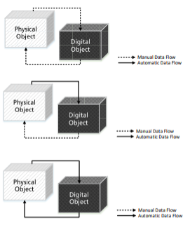
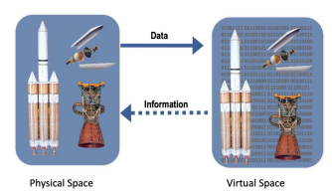
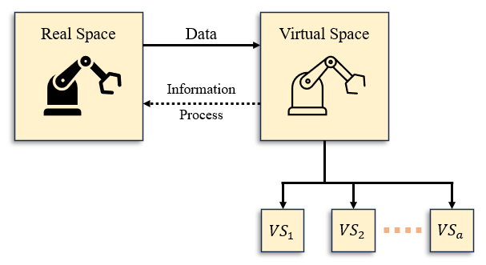
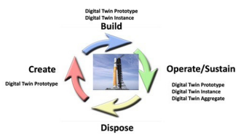
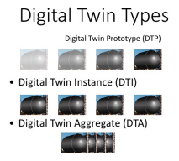
Redefining the Digital Twin: History of the DT Concept
2012
First specific definition of DTs for aerospace domain published by Glaessgen and Stargel in accordance with NASA. [2]
2017
Grieves and Vickers DT publication introducing GTV along with other early ideas for DT types (DTP, DTI, DTE). [7]
1960
NASA uses DT concept to simulate rescue scenarios in space for Apollo 13 mission. [2]
2002
Grieves presents the first proposal of DT for PLM at the SME conference in Troy, Michigan. [4]
2022
Research&Markets predicts the global DT market will reach $73.5 billion by 2027. [9]
1960 1990 2000 2005 2010 2012 2014 2016 2018 2020
1997
Hernández published using DT for iterative design of urban road networks using digital modeling. [3]
2006
Helen Gill coins the phrase “cyber-physical systems” (CPS). [5]
2011
Marks the start of the fourth industrial revolution
(Industry 4.0)
2014
Grieves publishes his white paper on DTs, 3-dimensional model. [6]
2018
Kritzinger publishes his review of DT literature, categorizing articles based on levels of data integration (DM, DS, DT). [8]
2023
Grieves publishes another paper highlighting DT fallacies, reworking DT types (DTP, DTI, DTA), and adding predictive testing to GTV. [10]
Overview
Material
Reducing PU
Reducing Nylon
Simulation
Recommendations
[Agenda 1]
Research Questions
Manuscript 1
[Agenda 4]
[Agenda 5]
Problem Statement
Concepts & Definitions
Manuscript Review
Recommendations
Conclusion
Overview
[Agenda 2]
[Agenda 3]
6

Slide 7
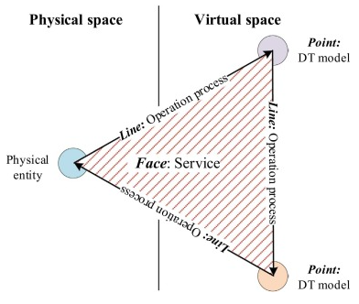
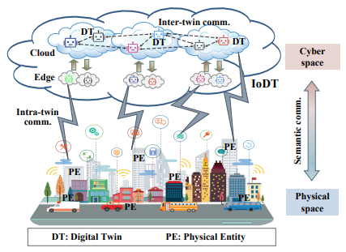
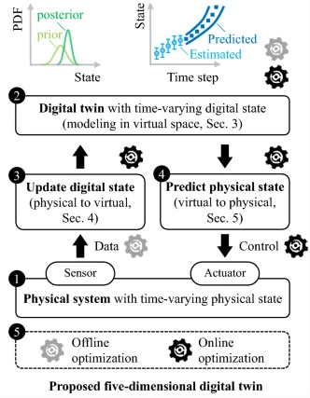
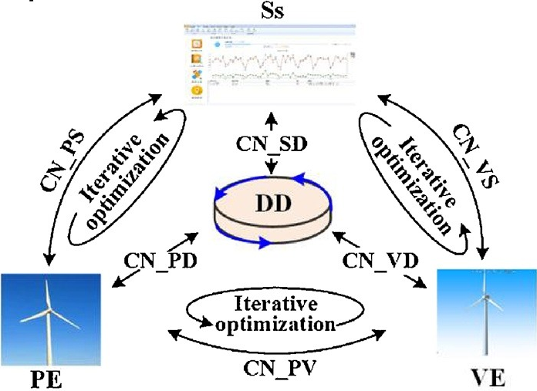
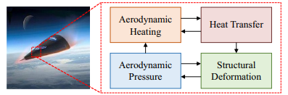
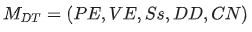
Redefining the Digital Twin: Definitions of Digital Twins
Publications of DT technology exponentially increased between 2017 and 2021.
Many researchers focused on classification and generalization based on the works of Kritzinger.
We mainly see two distinct model architectures:
3-Dimensional (following Grieves’ definition)
5-Dimensional (initially presented by Tao in 2018).
Over the years, DT definitions moved away from simulations and physics-based modelling structures to focusing on the automatic, bi-directional, transfer of data between physical and virtual spaces.
Model synchronization, while great for predictive operations, could be problematic.
3-Dimensional DTMaS model
proposed by Liu. [11]
IoDT model proposed by Wang. [12]
Coupled multiphysics simulation of a hypersonic vehicle panel. [1]
5-Dimesional DT model proposed by Tao. [13]
5-Dimesional DT model proposed by Thelen. [1]
[Agenda 1]
Reducing Nylon
Simulation
Recommendations
Overview
[Agenda 1]
Material
Research Questions
Research Questions
Reducing PU
Manuscript 1
Manuscript 1
[Agenda 4]
Reducing Nylon
[Agenda 4]
[Agenda 5]
Recommendations
Overview
[Agenda 5]
Problem Statement
Concepts & Definitions
Manuscript Review
Recommendations
Conclusion
[Agenda 2]
[Agenda 2]
[Agenda 3]
Material
[Agenda 3]
Overview
Reducing PU
7

Slide 8
Redefining the Digital Twin: Definition Proposal
Our proposed definition of DT:
“The digital twin (DT) is a super high-fidelity simulation model which replicates the behavior of a given physical entity, with an emphasis on achieving a high level of similarity in its data output. The inclusion of a bi-directional data transfer is inherently optional and should only be applied to situations which warrant its use (for example in the application of predictive operations, for which these DTs should be referred to as something along the lines of Predictive Twin (PT)).
Rather than focusing on how to implement generalized DT frameworks that could apply to multiple use-cases across various industries, DTs should be defined on a problem specific basis with a standardized validation method. This standardized method would subsequently be used to realize a level of fidelity above a statistically significant threshold, allowing DT models to reliably solve a given question through 'what-if' scenarios.
The classification framework for DTs proposed in this study is based on the fidelity levels of simulation models. A model is considered a DT only when it exceeds a defined validation threshold. Yet, there is a maximum fidelity level; surpassing this level results in the model merging with its physical counterpart, transforming the DT into what is essentially a SCADA system with enhanced visualization and predictive capabilities.” – Manuscript 1.6.2
Overview
Material
Reducing PU
Reducing Nylon
Simulation
Recommendations
[Agenda 1]
Research Questions
Manuscript 1
[Agenda 4]
[Agenda 5]
Problem Statement
Concepts & Definitions
Manuscript Review
Recommendations
Conclusion
Overview
[Agenda 2]
[Agenda 3]
8

Slide 9
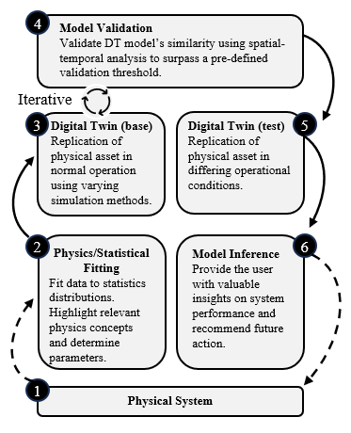
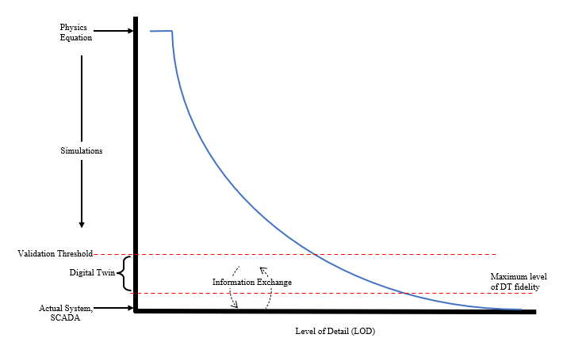
Redefining the Digital Twin: Definition Proposal (cont.)
Overview
Material
Reducing PU
Reducing Nylon
Simulation
Recommendations
[Agenda 1]
Research Questions
Manuscript 1
[Agenda 4]
[Agenda 5]
Problem Statement
Concepts & Definitions
Manuscript Review
Recommendations
Conclusion
Overview
[Agenda 2]
[Agenda 3]
9

Slide 10
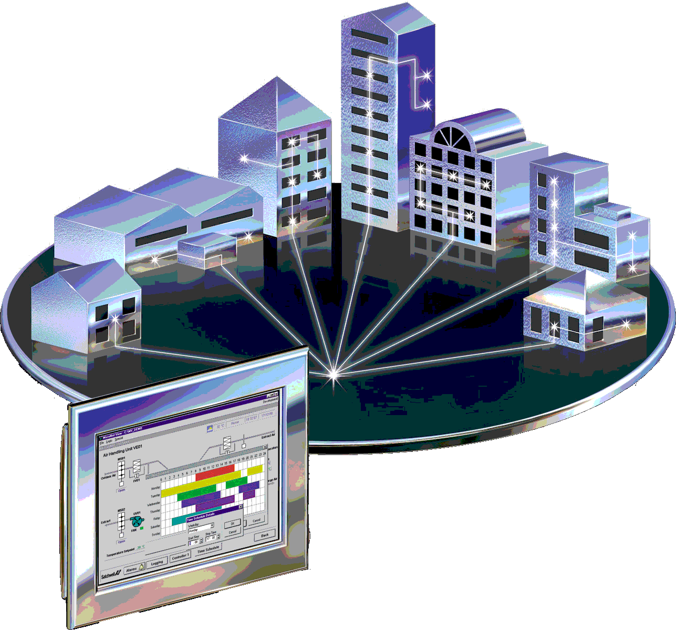
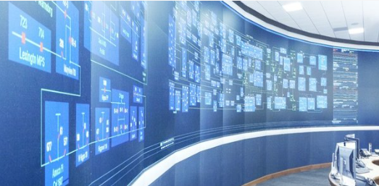
SCADA Systems: Definition & Applications
Definition:
Supervisory Control And Data Acquisition (SCADA)
A system of software and hardware elements that allows industrial organizations to:
Control processes locally or remotely.
Monitor, gather, and process real-time data.
Directly interact with devices such as sensors, valves, pumps, motors, and more.
This Photo by Unknown Author is licensed under CC BY-ND
Applications:
Applicable in Multiple Sectors:
Pivotal in the energy and utilities sector.
Transforming manufacturing practices.
Providing the future of efficient transportation.
Safe management of water and wastewater facilities.
Others (agriculture, mining, healthcare, etc.)
Overview
Material
Reducing PU
Reducing Nylon
Simulation
Recommendations
[Agenda 1]
Research Questions
Manuscript 1
[Agenda 4]
[Agenda 5]
Problem Statement
Concepts & Definitions
Manuscript Review
Recommendations
Conclusion
Overview
[Agenda 2]
[Agenda 3]
10

Slide 11
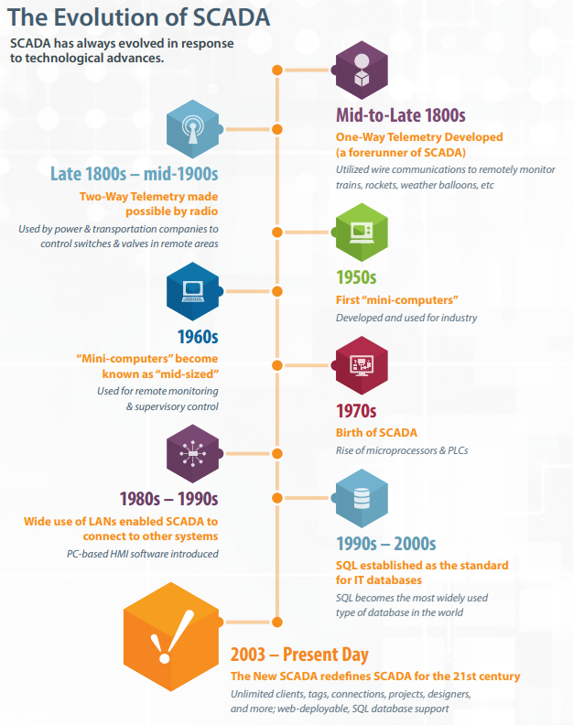
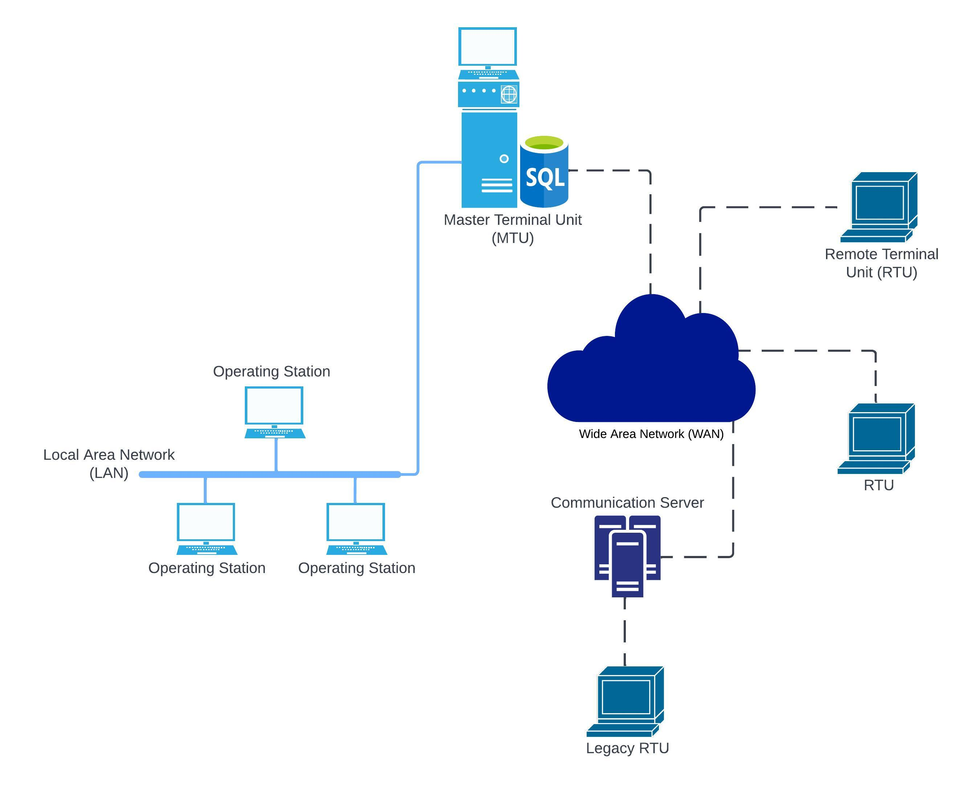
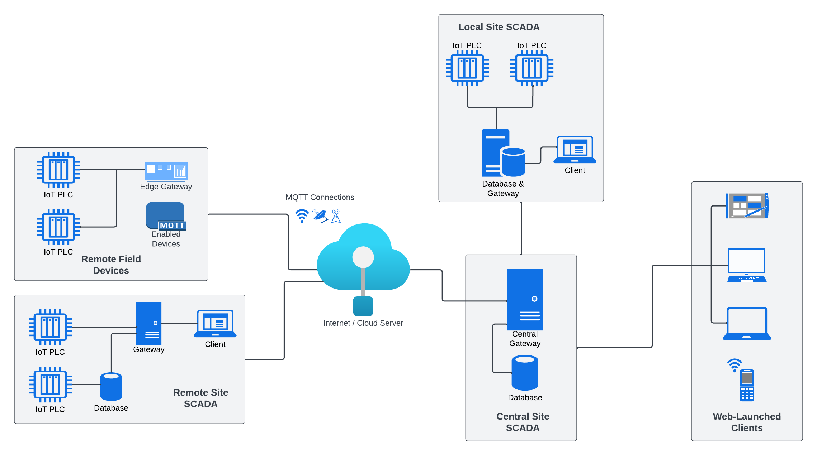
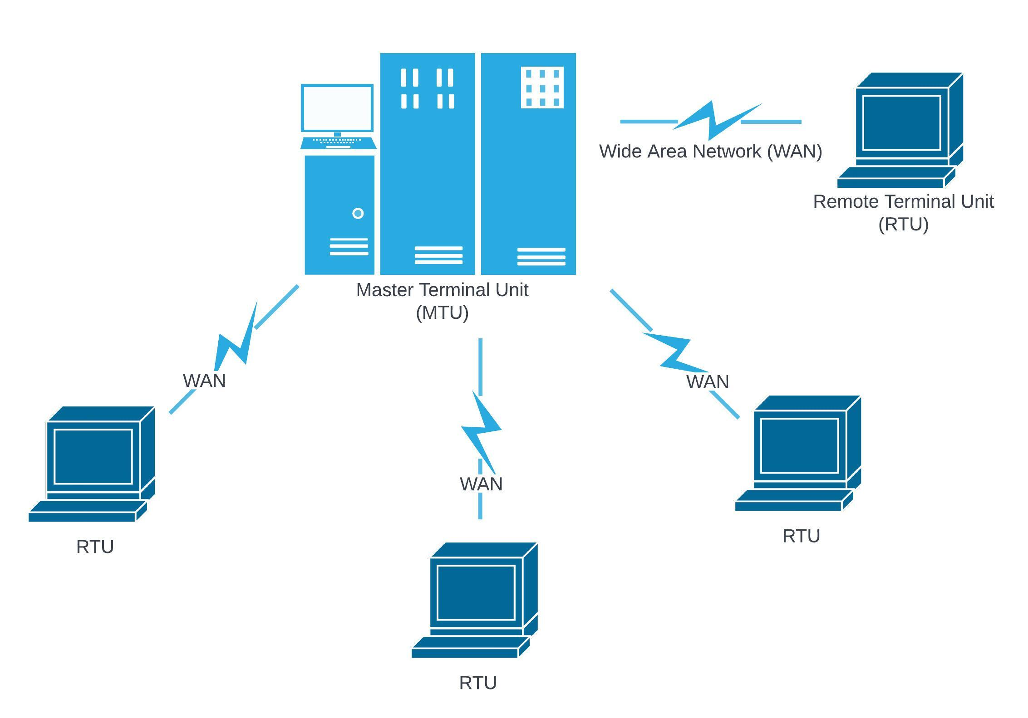
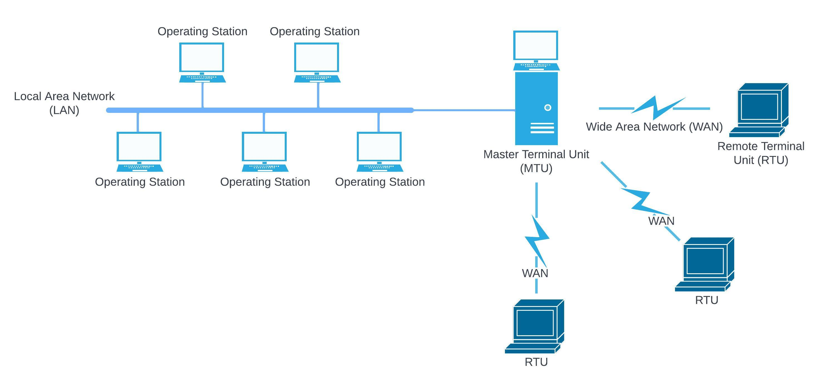
SCADA Systems: Evolution
Monolithic
SCADA
Distributed
SCADA
1980s – Second generation of SCADA systems
Introduction of communication over LAN (Local Area Network) technology.
“Operating stations” were integrated into the system.
For real-time observation and manipulation of equipment, allowing for decentralized control.
Downfall:
Proprietary software and hardware, limiting interoperability.
Networked
SCADA
1990s – Third Generation of SCADA system.
Driven by demand for highly-automated processes
Data could be transferred over public networks, expanding reach and capabilities.
Integration with other business systems became possible via differing internet protocols such as: Modbus, DNP3, MQTT, etc.
Open system (non-proprietary) architecture emerged, allowing for greater connectivity.
1960s - First generation of SCADA technology
Used for simple monitoring tasks with limited control capabilities.
Initial systems were standalone with no network connectivity.
Mainframe-based system
Downfall of Monolithic systems:
Proprietary nature of the technology.
2000s & Beyond– Fourth generation of SCADA systems
Integration with IT and web-based applications.
Embracing of IoT, cloud computing, and advanced data analytics.
Focus on cybersecurity due to increased connectivity and potential vulnerabilities
Modern
SCADA
[14]
Overview
Material
Reducing PU
Reducing Nylon
Simulation
Recommendations
[Agenda 1]
Research Questions
Manuscript 1
[Agenda 4]
[Agenda 5]
Problem Statement
Concepts & Definitions
Manuscript Review
Recommendations
Conclusion
Overview
[Agenda 2]
[Agenda 3]
11

Slide 12
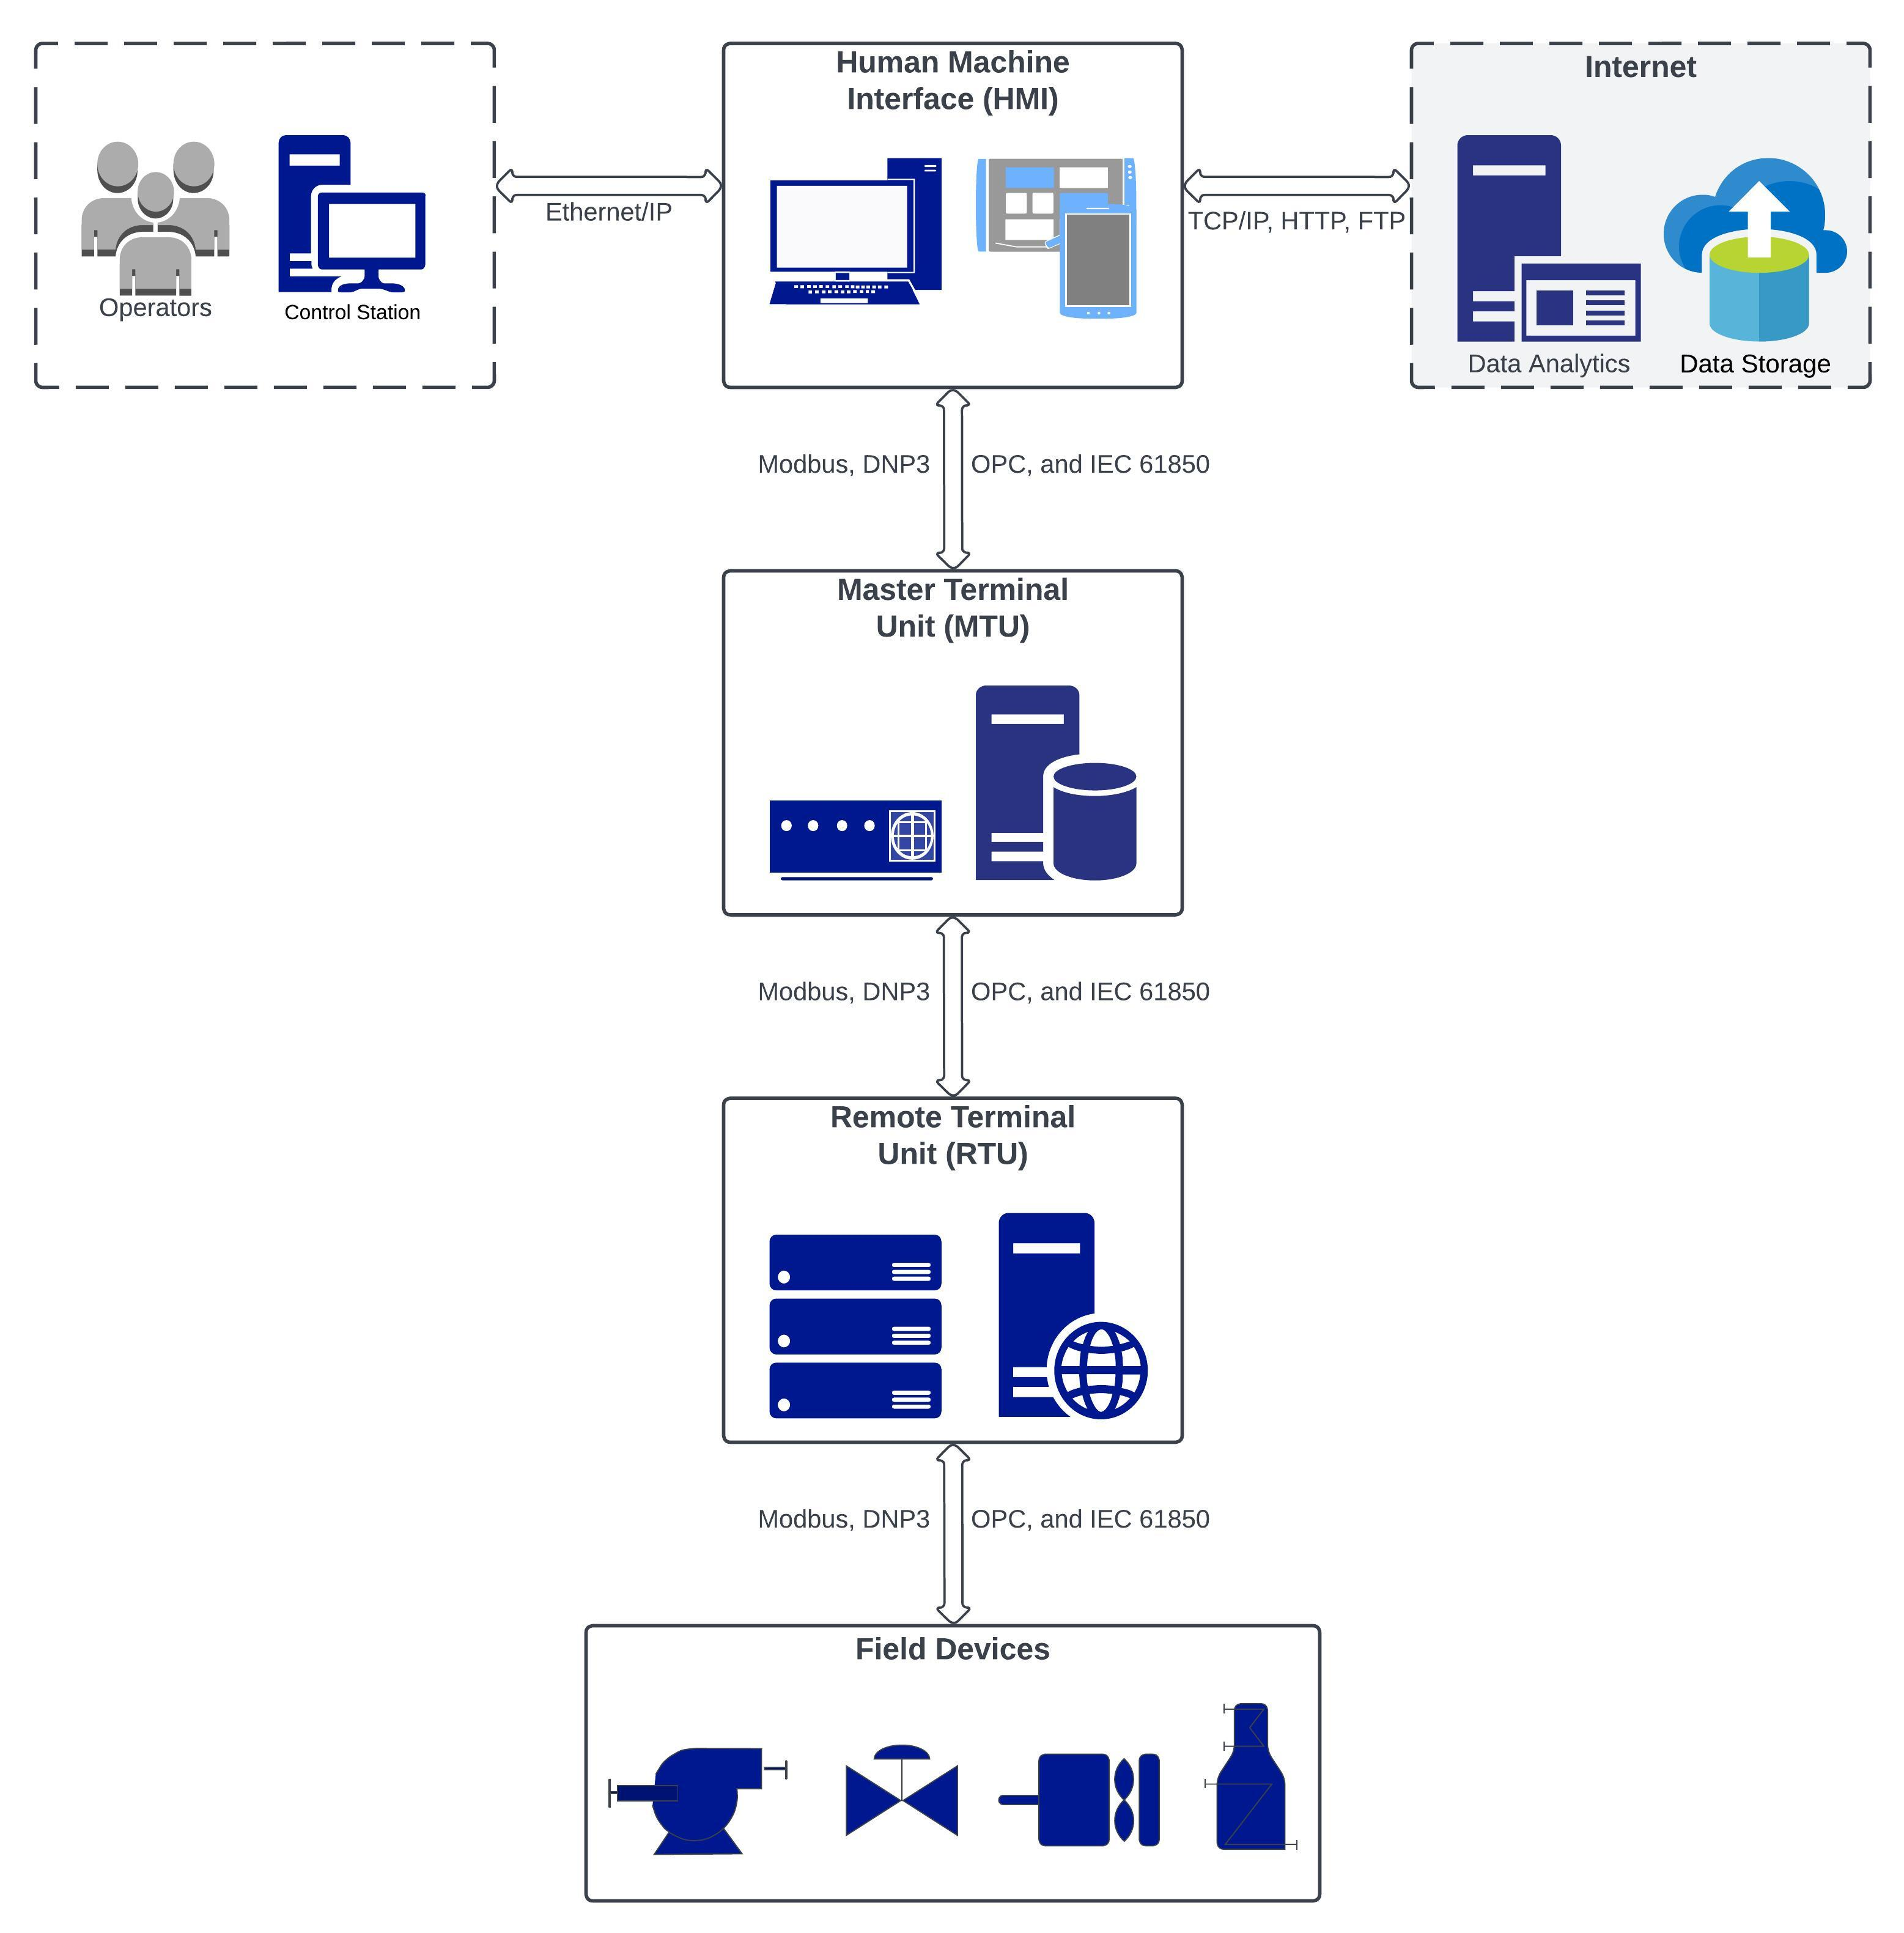
SCADA Systems: Modern Capabilities and Outlook
Modern SCADA Capabilities
Data Acquisition
Real-time Control
Alarm Management
Data Storage & Analysis
Process Optimization
Future of SCADA
Integration with Internet of Things (IOT)
Cloud-based SCADA
Mobil SCADA
Predictive maintenance
Advancements modern cyber security
Overview
Material
Reducing PU
Reducing Nylon
Simulation
Recommendations
[Agenda 1]
Research Questions
Manuscript 1
[Agenda 4]
[Agenda 5]
Problem Statement
Concepts & Definitions
Manuscript Review
Recommendations
Conclusion
Overview
[Agenda 2]
[Agenda 3]
12
Notes:
SCADA systems offer high-level supervision of machines and processes, combining computers, networked data communications, and graphical user interfaces.

Slide 13


Data-Driven Defense for Smart Manufacturing: Problem Statement & Relevant Definitions
Problem Statement
The integration of unsecure IIOT devices into legacy manufacturing systems creates new entrance points for malicious actors to infiltrate and control potentially sensitive data. The integration of an Intrusion Detection System (IDS), backed by machine learning (ML) algorithms, allows stakeholders to identify and mitigate the effects of cyber attacks on their system before the damage is done. However, training these ML algorithms to detect such attacks can be time consuming, expensive, and potentially dangerous when dealing with cyber security applications. The IDS must be trained on data representing normal working condition along with that which contains cyber attacks for effective inference. To mitigate the risks posed by training IDS applications on real systems, we propose the use of artificial dataset generation through means of simulation modelling and proceed to test the use of varying ML models based on this generated dataset.
Attack Level
Cyber-attacks occurring at the application layer (ROS-level)
Relevant Definitions
IDS – Intrusion Detection System
ML – Machine Learning
LabFab – Testbed model-based manufacturing system
Overview
Material
Reducing PU
Reducing Nylon
Simulation
Recommendations
[Agenda 1]
Research Questions
Manuscript 1
[Agenda 4]
[Agenda 5]
Problem Statement
Concepts & Definitions
Manuscript Review
Recommendations
Conclusion
Overview
[Agenda 2]
[Agenda 3]
13

Slide 14
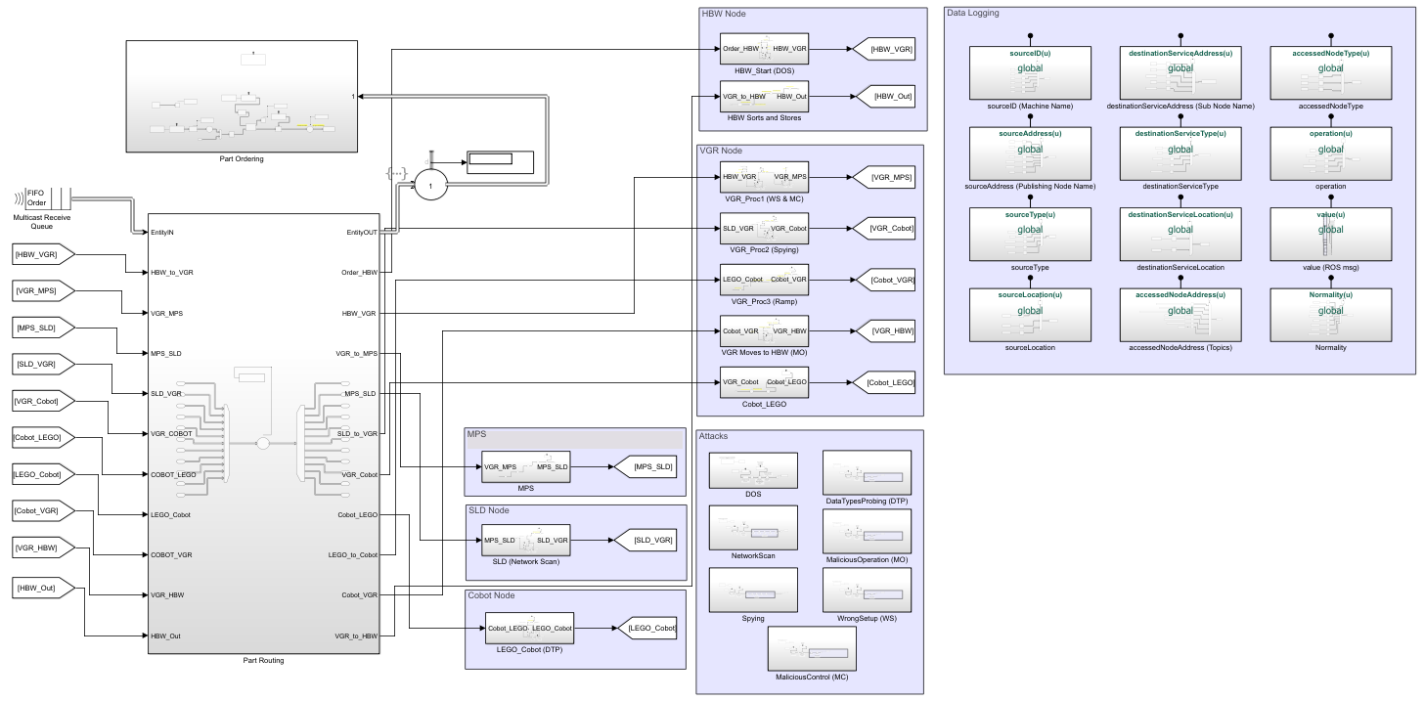
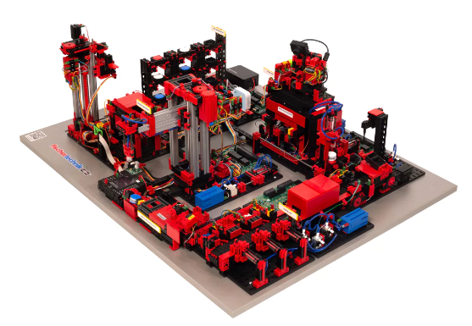
Data-Driven Defense for Smart Manufacturing: LabFab Case Study
Overview
Material
Reducing PU
Reducing Nylon
Simulation
Recommendations
[Agenda 1]
Research Questions
Manuscript 1
[Agenda 4]
[Agenda 5]
Problem Statement
Concepts & Definitions
Manuscript Review
Recommendations
Conclusion
Overview
[Agenda 2]
[Agenda 3]
14

Slide 15
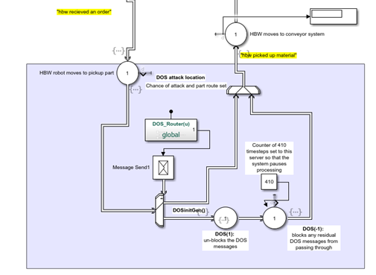
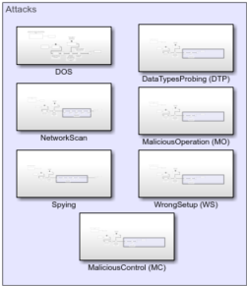
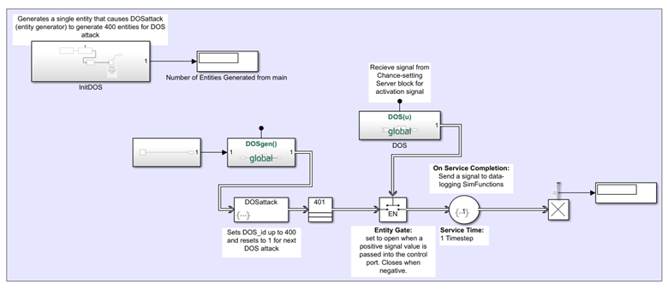
Data-Driven Defense for Smart Manufacturing: LabFab Case Study Attacks
Attack Types:
Denial Of Service (DOS) – When a single source service sends too many requests to the same destination service over and over.
Network Scan – Too many requests coming from the same source to many random destination services.
Spying – Too many read requests from one source to many destination services of the same type.
Data Types Probing – Sending data of different types than the one assigned to the target.
Malicious Operation – One source service attempts to access a destination service with improper operation type.
Wrong Setup – An access attempt from one source to a destination service in the wrong location.
Malicious Control – When one request from a source service sends a request to an irrelevant destination service.
Overview
Material
Reducing PU
Reducing Nylon
Simulation
Recommendations
[Agenda 1]
Research Questions
Manuscript 1
[Agenda 4]
[Agenda 5]
Problem Statement
Concepts & Definitions
Manuscript Review
Recommendations
Conclusion
Overview
[Agenda 2]
[Agenda 3]
15

Slide 16
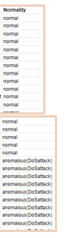
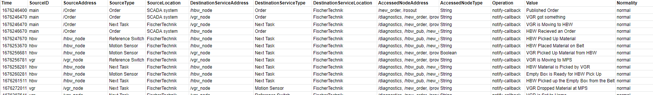
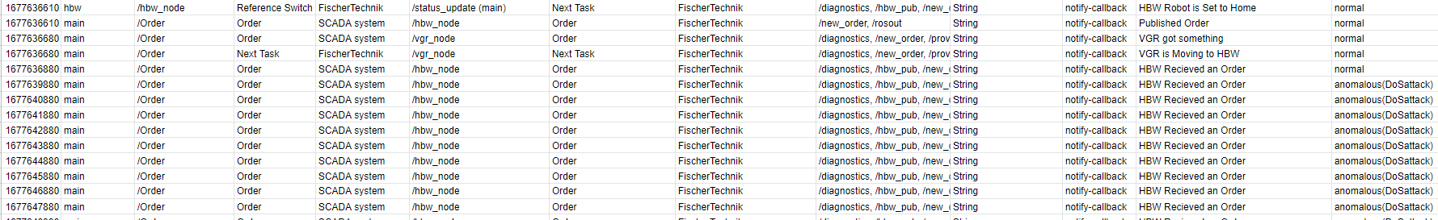
Data-Driven Defense for Smart Manufacturing: LabFab Case Study Data
Visualization:
Principal Component Analysis (PCA)
Proves data points are naturally separable
Provides good reasoning for ability to adequately identify classes
Data pre-processing:
Stratified train_test_split → (80% train, 20% test)
Ordinal Encoding → Transitioning from string-based to integer values
Min-Max Normalization → Large data values now range between 0 and 1
Class = ℝ(0,7)
Representing normal behavior and the 7 attack types.
Overview
Material
Reducing PU
Reducing Nylon
Simulation
Recommendations
[Agenda 1]
Research Questions
Manuscript 1
[Agenda 4]
[Agenda 5]
Problem Statement
Concepts & Definitions
Manuscript Review
Recommendations
Conclusion
Overview
[Agenda 2]
[Agenda 3]
16

Slide 17
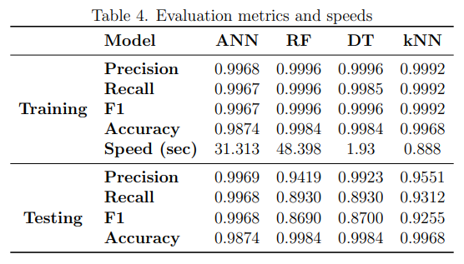
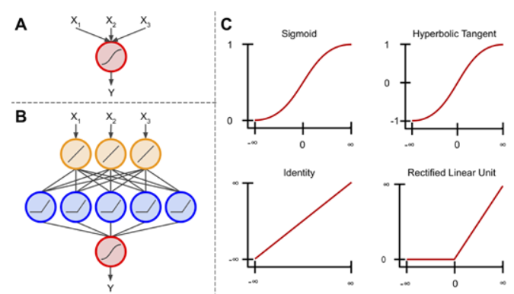
Data-Driven Defense for Smart Manufacturing: Results & Discussion
Results:
Proved that it is possible to train a ML-based anomaly detection systems on artificial data generated through simulation.
Provides a good case for safe and effective cyber security implementation.
Slower training speed
Faster training speed: good for evolving systems
Artificial Neural Network
Random Forest
Decision Trees
Dataset
K-Nearest Neighbors
DT_1
DT_2
DT_3
Majority Vote Taken
Final Prediction
?
Overview
Material
Reducing PU
Reducing Nylon
Simulation
Recommendations
[Agenda 1]
Research Questions
Manuscript 1
[Agenda 4]
[Agenda 5]
Problem Statement
Concepts & Definitions
Manuscript Review
Recommendations
Conclusion
Overview
[Agenda 2]
[Agenda 3]
17

Slide 18
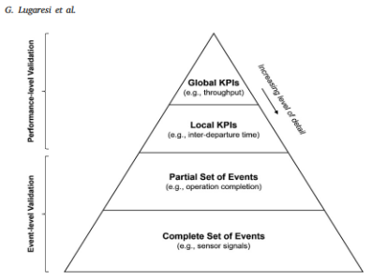
Digital Twin Validation: Problem Statement & Current Methods
Problem Statement
Validating digital twins is challenging due to the complexity of accurately representing physical systems and the need for specific similarity measures. There is no standardized validation framework, leading to discrepancies in approaches and concerns about the reliability and security of digital twins. The application of machine learning in establishing similarity measures for validation is still underdeveloped. There is a need for innovative methods to ensure the fidelity and practical application of digital twins across various industries.
Current Methods
Grieves Tests of Virtuality (GTV) [10][15]
Statistical methods (Uncertainty evaluation, Higher-Order Singular Value Decomposition, Divergence testing)[16][17][18][19]
Correspondence Measures [20]
Trace Alignment [21]
Data-Driven Validation (surrogate- modelling) [22]
Relevant Definitions
V&V – verification and validation
Overview
Material
Reducing PU
Reducing Nylon
Simulation
Recommendations
[Agenda 1]
Research Questions
Manuscript 1
[Agenda 4]
[Agenda 5]
Problem Statement
Concepts & Definitions
Manuscript Review
Recommendations
Conclusion
Overview
[Agenda 2]
[Agenda 3]
18

Slide 19
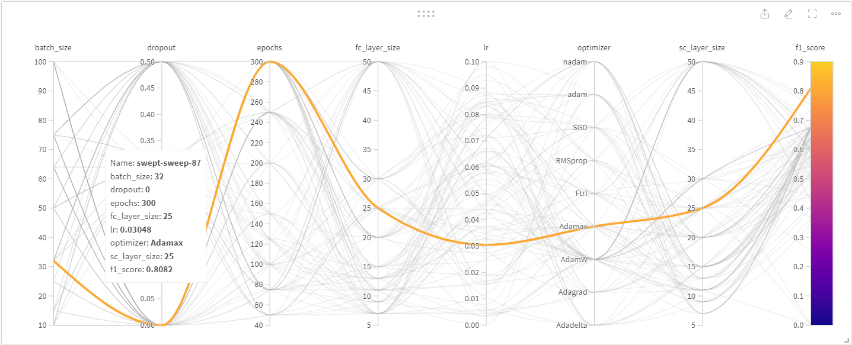
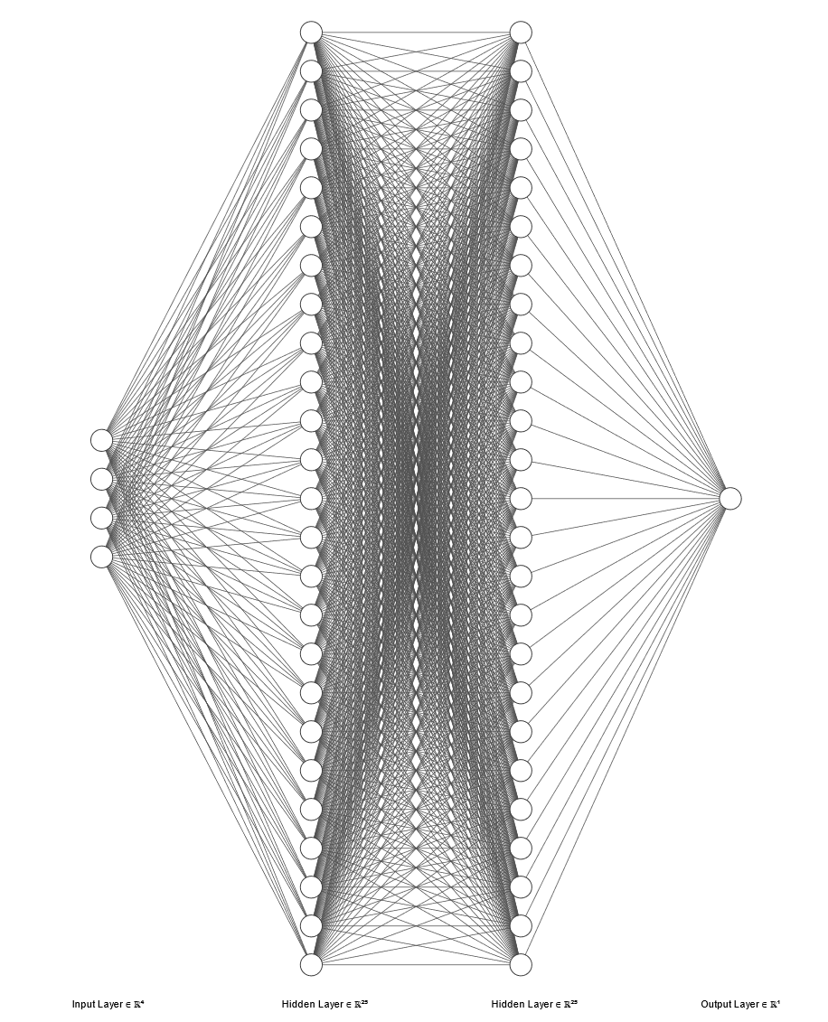
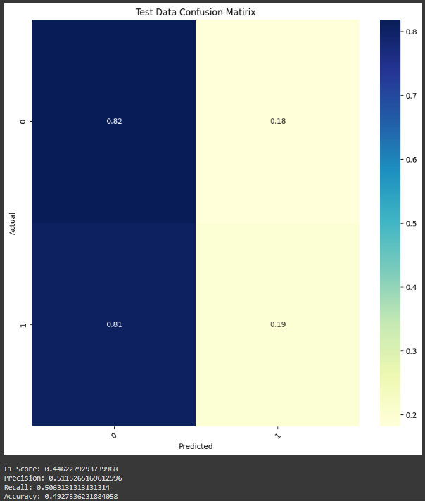
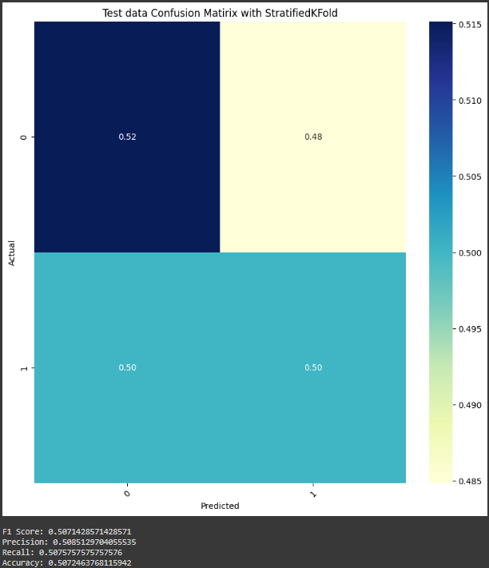
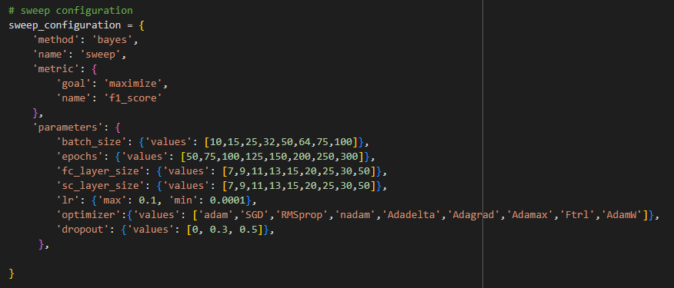
Digital Twin Validation: LabFab DT Validation Case Study
Proposal of ML Turing Test
Adaptation of GTV replacing the human with ML algorithm
Proof of concept
Using LabFab simulation to model normal system behavior
Artificial Neural Network (ANN) setup used for pattern recognition
Weights and Biases (WandB) sweeps used for parameter optimization
Tested multiple configurations of NN (adjusting the number of hidden layers)
Resulted in two cases
Run Time
Class Prediction:
Sim = 0
Real = 1
Message
Node
Topics
Case 2:
The model can only correctly classify the data 50% of the time.
Case 1:
The model classifies majority of data as simulated (type = 0), including those that are real (type = 1) or vice-versa.
Overview
Material
Reducing PU
Reducing Nylon
Simulation
Recommendations
[Agenda 1]
Research Questions
Manuscript 1
[Agenda 4]
[Agenda 5]
Problem Statement
Concepts & Definitions
Manuscript Review
Recommendations
Conclusion
Overview
[Agenda 2]
[Agenda 3]
19

Slide 20
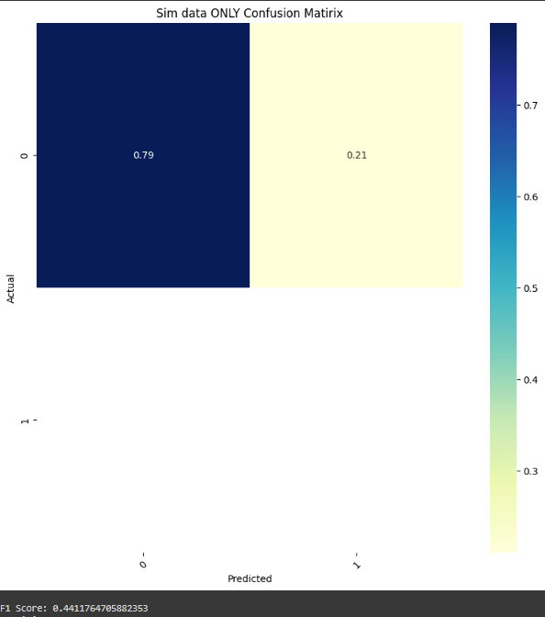
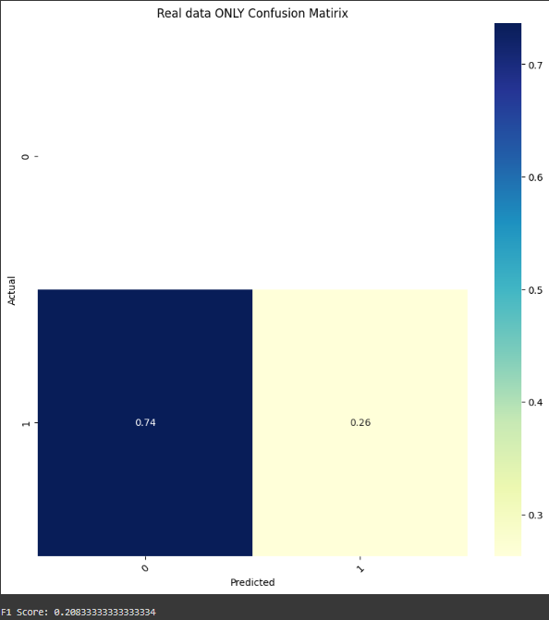
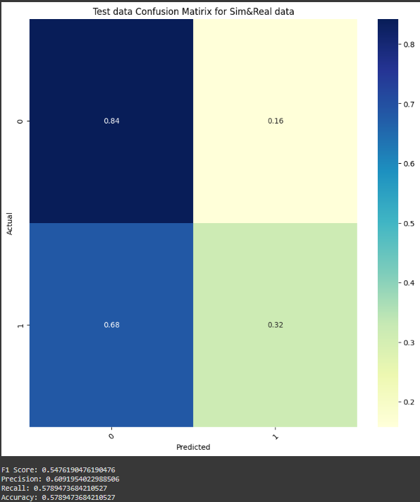
Digital Twin Validation: LabFab DT Validation Case Study
Experiment 1:
Expose the trained model to an external set of simulated data only. (Class = 0)
Experiment 2:
Expose the trained model to an external set of real data only. (Class = 1)
Experiment 3:
Expose the trained model to an external set of simulated and real data.
Overview
Material
Reducing PU
Reducing Nylon
Simulation
Recommendations
[Agenda 1]
Research Questions
Manuscript 1
[Agenda 4]
[Agenda 5]
Problem Statement
Concepts & Definitions
Manuscript Review
Recommendations
Conclusion
Overview
[Agenda 2]
[Agenda 3]
20

Slide 21
Recommendations for Future Work
Redefining the Digital Twin
Evaluate the existing validation techniques used and work towards creating a standardized validation method for DTs across various applications and levels of abstraction.
SCADA Systems
Further analysis of cyber-security measures that can be implemented across legacy systems to mitigate the risks when applying IOT devices.
Data-Driven Defense for Smart Manufacturing
Exploration into the use of bagging and boosting (the combination of ML architectures both in parallel and sequential order, respectively)
More in-depth modelling and application of methods to the Automatic Storage and Retrieval System (ASRS/HBW) to create a cyber-threat model applicable to specific areas within the manufacturing process.
Digital Twin Validation
Further exploration into the use of ML and AI algorithms for Digital Twin validation
Expansion of our case study using more data (both in terms of volume and higher detail)
Overview
Material
Reducing PU
Reducing Nylon
Simulation
Recommendations
[Agenda 1]
Research Questions
Manuscript 1
[Agenda 4]
[Agenda 5]
Problem Statement
Concepts & Definitions
Manuscript Review
Recommendations
Conclusion
Overview
[Agenda 2]
[Agenda 3]
21

Slide 22
Conclusion
Regardless of our stance on the application of Digital Twins (DTs) in industry, from their definition and classification to validation methods and future potential, it's crucial to recognize that this concept will continue to evolve. The insights and methodologies presented in our research may not immediately alter the existing practices of industry professionals. The prevalent mindset of maintaining the status quo unless necessary, often stated as "If it isn’t broken, don’t fix it", remains a significant barrier to the adoption of novel technologies in industrial processes.
Nonetheless, it is essential to challenge and re-assess established norms. The primary motivation behind this manuscript is to contribute to the ongoing advancement of DT technology. It is my aspiration that this work will encourage others to persistently challenge the status quo.
Overview
Material
Reducing PU
Reducing Nylon
Simulation
Recommendations
[Agenda 1]
Research Questions
Manuscript 1
[Agenda 4]
[Agenda 5]
Problem Statement
Concepts & Definitions
Manuscript Review
Recommendations
Conclusion
Overview
[Agenda 2]
[Agenda 3]
22

Slide 23

Thank you!
________________________
Questions?

Slide 24
References
[1] | A. Thelen, X. Zhang, O. Fink, Y. Lu, S. Ghosh, B. D. Youn, M. D. Todd, S. Mahadevan, C. Hu, and Z. Hu, “A comprehensive review of digital twin—part 1: modeling and twinning enabling technologies,” Structural and Multidisciplinary Optimization, vol. 65, no. 12, p. 354, 2022.
[2] | E. Glaessgen and D. Stargel, “The digital twin paradigm for future nasa and us air force vehicles,” in 53rd AIAA/ASME/ASCE/AHS/ASC structures, structural dynamics and materials conference 20th AIAA/ASME/AHS adaptive structures conference 14th AIAA, 2012, p. 1818.
[3] | L. Hernández and S. Hernández, “Application of digital 3d models on urban planning and highway design.” WIT Transactions on The Built Environment, vol. 33, 1997.
[4] | M. Grieves, “Completing the cycle: Using plm information in the sales and service functions [slides],” in SME Management Forum, 2002.
[5] | X. Liu, D. Jiang, B. Tao, F. Xiang, G. Jiang, Y. Sun, J. Kong, and G. Li, “A systematic review of digital twin about physical entities, virtual models, twin data, and applications,” Advanced Engineering Informatics, vol. 55, p. 101876, 2023.
[6] | M. Grieves, “Digital twin: manufacturing excellence through virtual factory replication,” White paper, vol. 1, no. 2014, pp. 1–7, 2014.
[7] | M. Grieves and J. Vickers, “Digital twin: Mitigating unpredictable, undesirable emergent behavior in complex systems,” Transdisciplinary perspectives on complex systems: New findings and approaches, pp. 85–113, 2017.
[8] | W. Kritzinger, M. Karner, G. Traar, J. Henjes, and W. Sihn, “Digital twin in manufacturing: A categorical literature review and classification,” IfacPapersOnline, vol. 51, no. 11, pp. 1016–1022, 20
[9] | Y. Wang, Z. Su, S. Guo, M. Dai, T. H. Luan, and Y. Liu, “A survey on digital twins: architecture, enabling technologies, security and privacy, and future prospects,” IEEE Internet of Things Journal, 2023.
[10] | M. W. Grieves, “Digital twins: Past, present, and future,” in The Digital Twin. Springer, 2023, pp. 97–121.
[11] | S. Liu, J. Bao, and P. Zheng, “A review of digital twin-driven machining: From digitization to intellectualization,” Journal of Manufacturing Systems, vol. 67, pp. 361–378, 2023.
[12] | Y. Wang, Z. Su, S. Guo, M. Dai, T. H. Luan, and Y. Liu, “A survey on digital twins: architecture, enabling technologies, security and privacy, and future prospects,” IEEE Internet of Things Journal, 2023.
[13] | Tao, H. Zhang, A. Liu, and A. Y. Nee, “Digital twin in industry: Stateof-the-art,” IEEE Transactions on industrial informatics, vol. 15, no. 4, pp. 2405–2415, 2018.
[14] | I. Automation, “The new scada,” Jun 2014. [Online]. Available: https: //inductiveautomation.com/resources/article/old-scada-vs-the-new-scada
[15] | R. Al-Sehrawy and B. Kumar, “Digital twins in architecture, engineering, construction and operations. a brief review and analysis,” in Proceedings of the 18th International Conference on Computing in Civil and Building Engineering: ICCCBE 2020. Springer, 2021, pp. 924–939.
[16] | L. Wright and S. Davidson, “How to tell the difference between a model and a digital twin,” Advanced Modeling and Simulation in Engineering Sciences, vol. 7, no. 1, pp. 1–13, 2020.
[17] | G. Lugaresi, S. Gangemi, G. Gazzoni, and A. Matta, “Online validation of digital twins for manufacturing systems,” Computers in Industry, vol. 150, p. 103942, 2023.
[18] | W. Qian, Y. Guo, K. Cui, P. Wu, W. Fang, and D. Liu, “Multidimensional data modeling and model validation for digital twin workshop,” Journal of Computing and Information Science in Engineering, vol. 21, no. 3, p. 031005, 2021.
[19] | F. Emmert-Streib, “Defining a digital twin: A data science-based unification,” Machine Learning and Knowledge Extraction, vol. 5, no. 3, pp. 1036–1054, 2023.
[20] | T. H. Khan, C. Noh, and S. Han, “Correspondence measure: a review for the digital twin standardization,” The International Journal of Advanced Manufacturing Technology, pp. 1–21, 2023.
[21] | P. Muñoz, M. Wimmer, J. Troya, and A. Vallecillo, “Using trace alignments for measuring the similarity between a physical and its digital twin,” in Proceedings of the 25th International Conference on Model Driven Engineering Languages and Systems: Companion Proceedings, 2022, pp. 503–510.
[22] | R. Söderberg, K. W¨armefjord, J. S. Carlson, and L. Lindkvist, “Toward a digital twin for real-time geometry assurance in individualized production,” CIRP annals, vol. 66, no. 1, pp. 137–140, 2017.

Slide 25
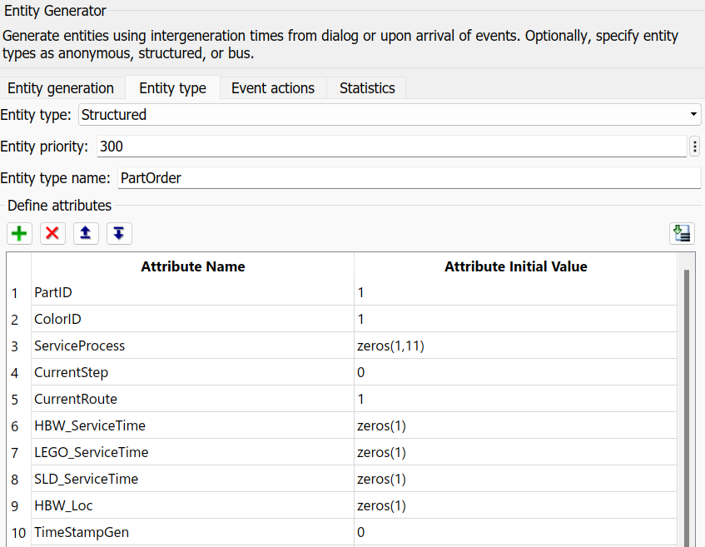
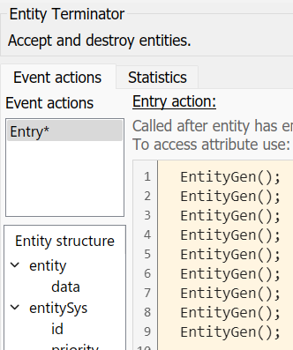
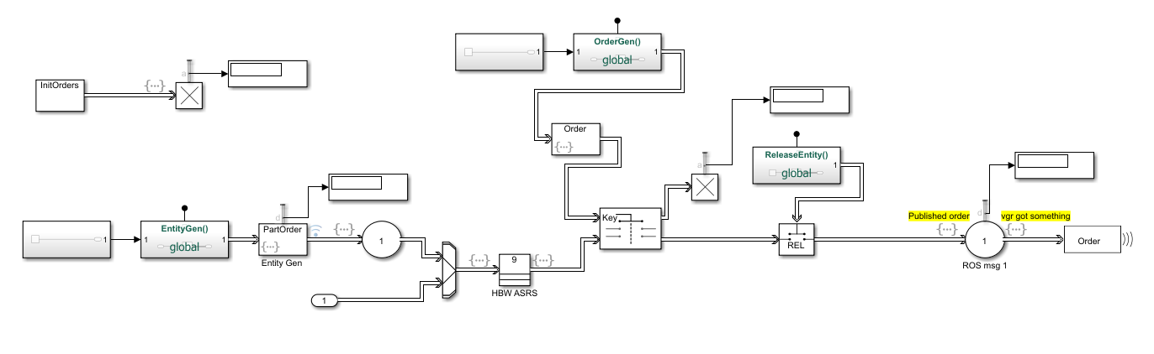
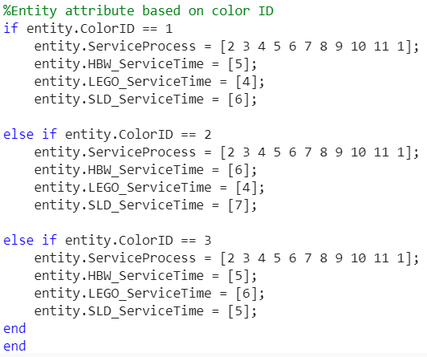
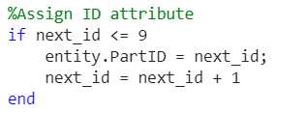
Data-Driven Defense for Smart Manufacturing: LabFab Case Study
OrderGen()
Entity Event Actions: Generate
Overview
Material
Reducing PU
Reducing Nylon
Simulation
Recommendations
[Agenda 1]
Research Questions
Manuscript 1
[Agenda 4]
[Agenda 5]
Problem Statement
Concepts & Definitions
Manuscript Review
Recommendations
Conclusion
Overview
[Agenda 2]
[Agenda 3]
25

Slide 26
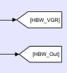
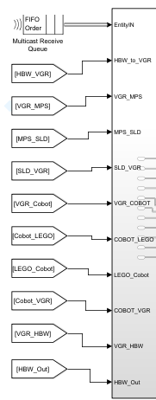






Data-Driven Defense for Smart Manufacturing: LabFab Case Study
“From”
This block-type is used to receive entities from a matching tag and output into the routing subsystem
“Goto”
This block-type is used to send entities from process blocks into the routing subsystem
Overview
Material
Reducing PU
Reducing Nylon
Simulation
Recommendations
[Agenda 1]
Research Questions
Manuscript 1
[Agenda 4]
[Agenda 5]
Problem Statement
Concepts & Definitions
Manuscript Review
Recommendations
Conclusion
Overview
[Agenda 2]
[Agenda 3]
26

Slide 27



Data-Driven Defense for Smart Manufacturing: LabFab Case Study
From Server Entry Action
To Source Address Simulink Function
Out To Workspace
Overview
Material
Reducing PU
Reducing Nylon
Simulation
Recommendations
[Agenda 1]
Research Questions
Manuscript 1
[Agenda 4]
[Agenda 5]
Problem Statement
Concepts & Definitions
Manuscript Review
Recommendations
Conclusion
Overview
[Agenda 2]
[Agenda 3]
27

Slide 28

Data-Driven Defense for Smart Manufacturing: LabFab Case Study
Overview
Material
Reducing PU
Reducing Nylon
Simulation
Recommendations
[Agenda 1]
Research Questions
Manuscript 1
[Agenda 4]
[Agenda 5]
Problem Statement
Concepts & Definitions
Manuscript Review
Recommendations
Conclusion
Overview
[Agenda 2]
[Agenda 3]
28

